Slide 1
Games Development 1
Review / Revision
CO2301 Games Development 1
Semester 2

Slide 2
Lecture Contents
3D Model & Data Import
Timing and the Game Loop
Sound Effects
Physics Engines
Game Architecture
Entities
Note: the material on the Unity game engine is not examinable

Slide 3
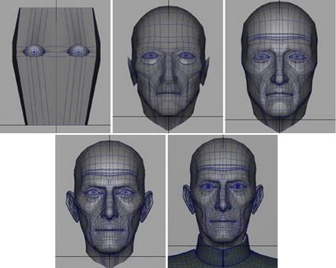
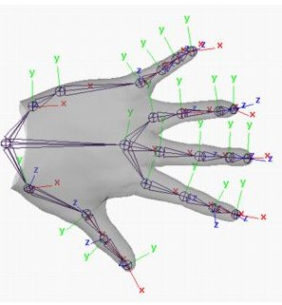
3D Model & Data Import 1
Computer games use 3D modelling tools to generate their content
  E.g. Alias Maya, 3ds Max
A modelling tool can also be used for content creation:
  Laying out scene related data: camera paths, AI networks etc.
  Authoring stats/attributes for visual elements
  Although may be better done in a Level Editor

Slide 4
3D Model & Data Import 2
Modelling tool’s native file formats are usually unsuitable for games use
Instead we can export in simpler formats (e.g. .X)
  Need 3rd party exporters, or…
Or write custom export scripts and file formats
  Allows the export of other game content too
Games have very particular technical requirements of their 3D models
  Artists not technically minded – communication critical
Wide range of game-specific & common sense requirements
  Equally wide range of possible artwork problems
  Agree ground rules with artists early on

Slide 5
Game Loops & Timing
A basic game loop performs in this manner:
  A static image of the scene is rendered
  The objects are moved slightly (where necessary)
  This process repeats as long as the game is running
If there is no timing in the loop then we render and update the scene as fast as possible
  Frequency of loop is dependent on the computer speed
  Will run at different speeds on different computers.
We need to time the game loop
  To determine how much to move/rotate models in the current scene update

Slide 6
Variable Timing
Time the game loop:
  Get an accurate measure of the time on each iteration of the game loop
  Subtract previous frame time from the current
  Gives us the time step since the last frame
Multiply movements in scene update by this time step (called the frame time or the update time)
  N.B. The frame rate (fps) = 1 / frame time
For example, for X movement at M units / second:
  Use MoveX( M * frame time )

Slide 7
Fixed Timing
Pick a fixed time period, e.g. 0.02s (= 50 FPS)
  Call this the tick
Measure everything in units / tick
Write scene update as normal using these values
  E.g. MoveX( 2 ) for a speed of 2 units per tick
Calculate FrameTime / tick
  Take whole part and call scene update this many times
  Carry the remainder over to the next frame
E.g. FrameTime / tick = 2.5
  Then perform 2 scene updates
  And save 0.5 to add to the result for the next frame

Slide 8
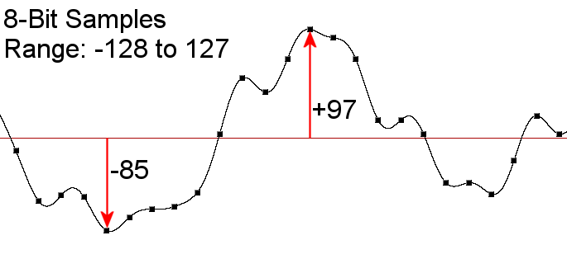
Sound Effects 1
A computer stores a sound by sampling its waveform
Samples taken at a fixed sample frequency (rate)
Each sample is a value representing the amplitude (pressure) of the waveform at that point
The bit-depth of the samples is the number of bits used for each sample and determines the accuracy of each sample

Slide 9
Sound Effects 2
Stereo sound consists of 2 waveforms, one for each ear
  Modelling differences in the perceived sound
  Pre-recorded so statically positioned
3D sound is the dynamic modelling of the different sounds received by our ears:
  Consider the 3D position of the mono sound source
  Then calculate how the sound emitted will be perceived at each ear of the observer
The Doppler effect is the compression / stretching of a sound due its velocity relative to the listener

Slide 10
Physics Engines 1
Physics engines simulate Newtonian physics for models in a scene
  Providing real-time simulation of movement / interaction
The game provides initial physical info for models
The physics engine performs the simulation and feeds back results to the game
Physics engines can simulate rigid or soft bodies
  Rigid body simulation is more common
Rigid bodies in a physics engine are represented by their collision volume
  Usually a simplification of the visual model

Slide 11
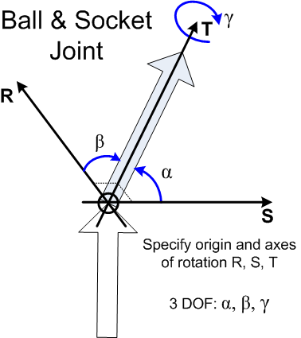
Physics Engines 2
A joint represents a constraint on a body
There are several kinds of joint typified by their degrees of freedom (d.o.f.) and the limits imposed on these d.o.f.
E.g. Hinge:
  One d.o.f. - rotation round an axis
  Specified by a point on the axis and the axis vector
Ball & Socket joint:
  Three d.o.f. round three fixed axes
  Specified by rotational origin & three axis vectors

Slide 12
Game Architecture 1
Game technologies should be written to be independent of platform, API and game
  Where possible without sacrificing efficiency
To generate such portable code:
  Create interfaces and abstract classes that idealise the function of a technology component
    Interfaces have function prototypes only – no implementation
    Abstract classes contain some implementation, but not all of it
  Use inherited implementation classes for each platform
  Use factory functions to instantiate objects for a particular platform
  Where possible put common (platform independent) code into abstract classes to encourage code reuse

Slide 13
Game Architecture 2
Avoid bloated “core” interfaces that perform too many diverse functions
Manager or system classes should be used to handle distinct roles in the overall system
  E.g. A mesh manager creates, deletes, loads and saves meshes in the game.
  The core interface simply creates and provides access to the mesh manager
UML diagrams help to build a class architecture
Aim to create Directed Acyclic Graphs (DAG) of class dependencies
  Strongly promotes loose coupling

Slide 14
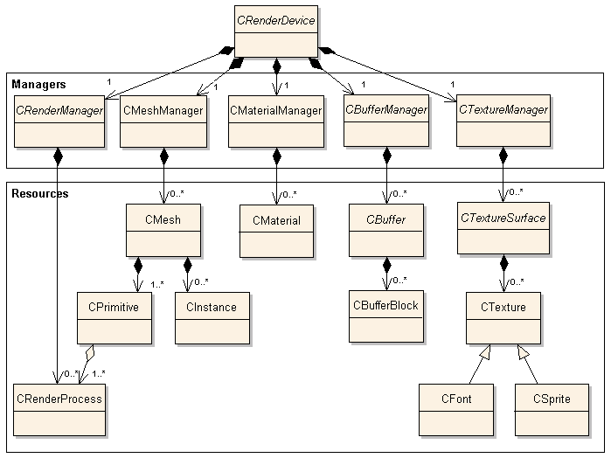
Game Architecture 3 (DAG)

Slide 15
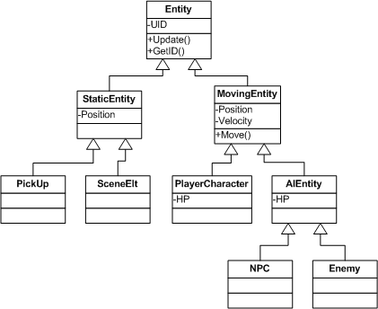
Game Entities 1
Game specific components are designed around the architecture of the game entities
  Single, self-contained, interactive game elements
Entities form a class hierarchy
A single entity might contain:
  Mesh and positioning, game attributes and stats, scripts etc.
Each entity has an update function
Most entities have a render function

Slide 16
Game Entities 2
Different components of the same game may different needs when referencing entities
Entities may be organised into several different data structures simultaneously
  E.g. Store a list in a entity manager, then have both a quadtree and a grid structure referring to entities in it
Entities may be updated each frame
  A priority queue can make this more efficient
Entities have unique identifiers (handles)
They can communicate with each other
  Simple messaging system

